Slide 1

FINAL PROJECT PRESENTATION
YDATA <> STELLANTIS
Amir Gorodetsky
Ariel Hagege
Nadav Maayani
Arpiné Kozmanyan
Marta Gajewska
Bartosz Bohaterewicz
Heather Goldsby
Xin Feng
Mentor:
Shani Kotler

Slide 2
AGENDA
Introduction
Dataset
Methodology and Modeling
Conclusions

Slide 3

INTRODUCTION

Slide 4

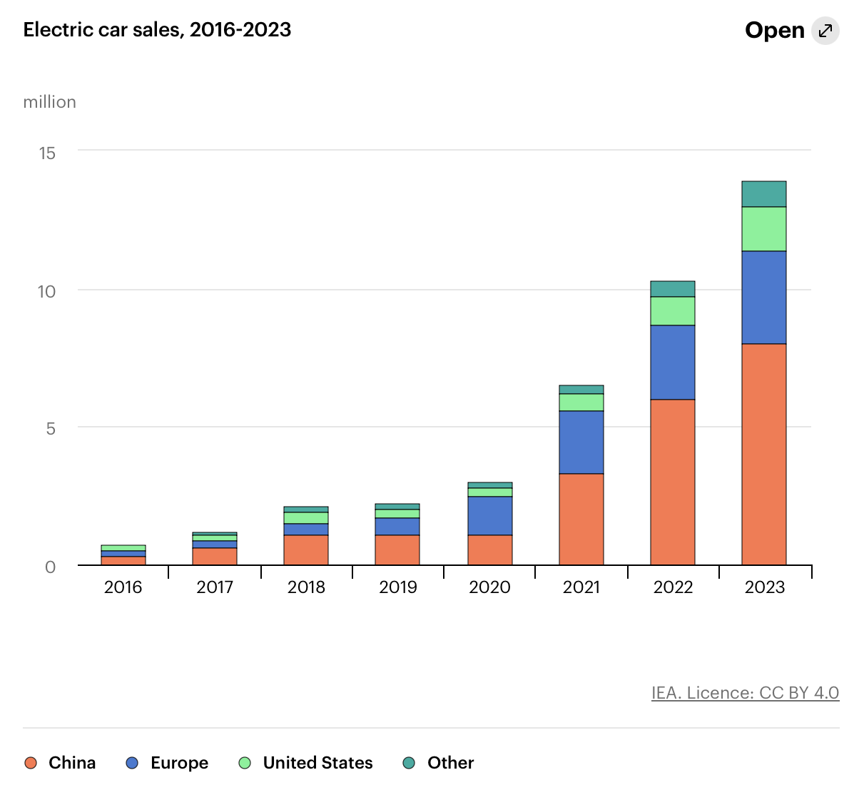
ELECTRIC ANXIETY⚡
Electric Vehicles (EVs) are awesome
Efficient
Reduce pollution
Better performance
EVs adoption main challenge - Range Anxiety 😱

Slide 5

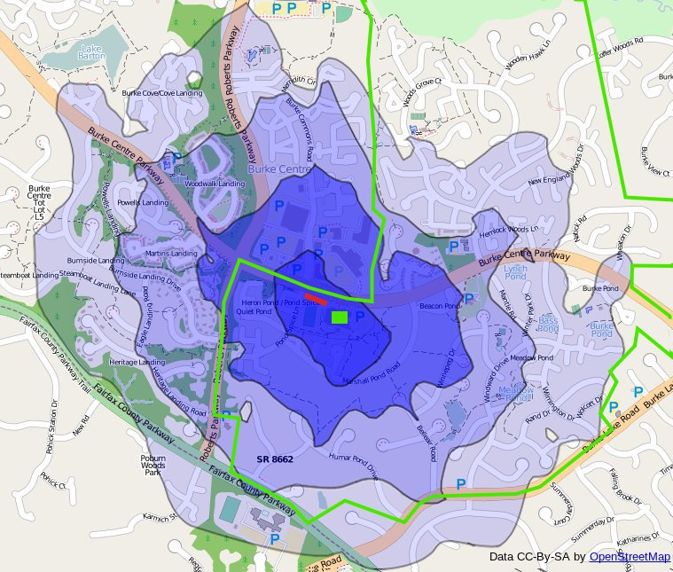
State-of-Charge predictions
Project value
Eliminates fear of running out of battery
Better route planning - include recharge stops
Better time estimates - include recharge time
Cost prediction
Distance map - SoC isochrones

Slide 6
The Project
Missions Statement
Predict battery state of charge at destination for a given route
Predict vehicle’s range given current battery level and location
Evaluate traditional vs. static methods
The Company
4th largest automaker by sales
14 car brands including Fiat, Peugeot, Citroen and Jeep
Dare Forward 2030 - 100% BEV car sales in Europe and 50% globally
Notes:
Battery Electric Vehicles

Slide 7

DATA

Slide 8
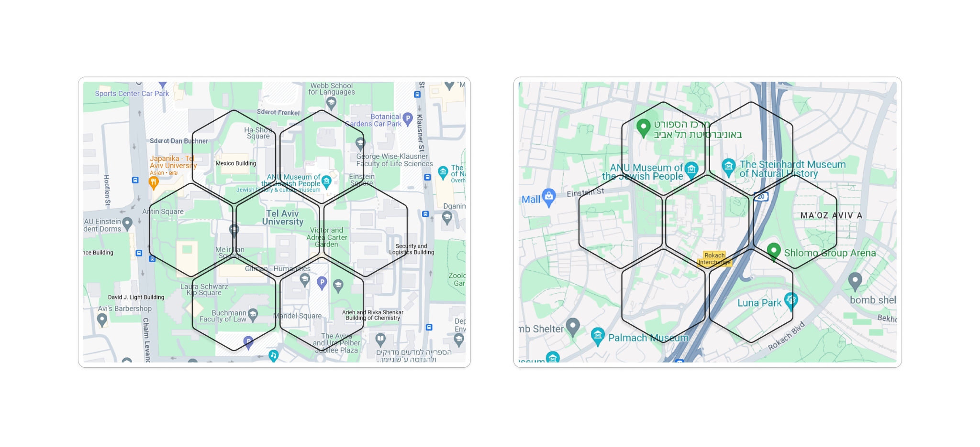
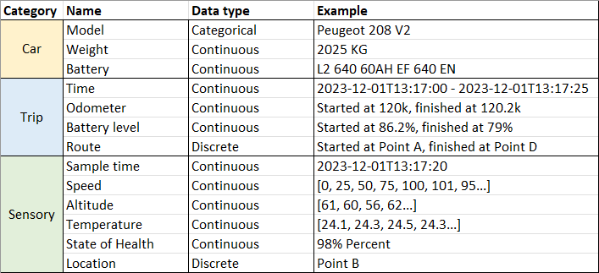
Dataset Overview
A single table with more than 10 million rows (13505184)
Samples from car trips - every minute
Features categories: car, trip and sensory
Time period: 4 Months - November 2023 to March 2024
Car models: Peugeot, Citroen, DS …
Location: France*
Target: State of Charge (0.1% sensitivity)
Notes:
a short overview of the data
we have a lot of data - more then 10M rows
every row is a segment of a trip representing 1 minute interval.
the locations were given as an Uber H3 hexagone. (it is Uber’s grid system)
target feature is the state of charge (SOC)
the data is comprised by 3 categories: car info (model, brand, weight etc..), trip info (id, start-end (SOC, odometer, ..)) and sensory data that is collected during the trip (speed, altitude, temperature and of course the battery SOC)

Slide 9
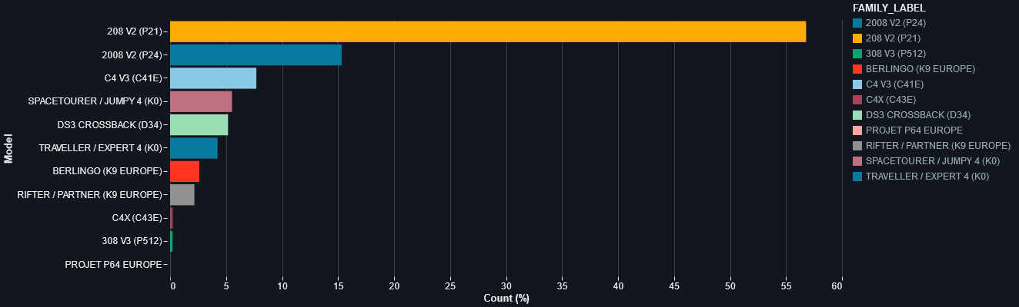
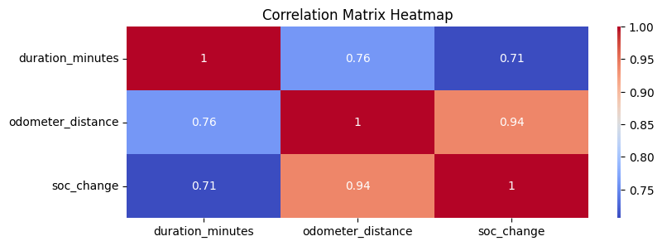
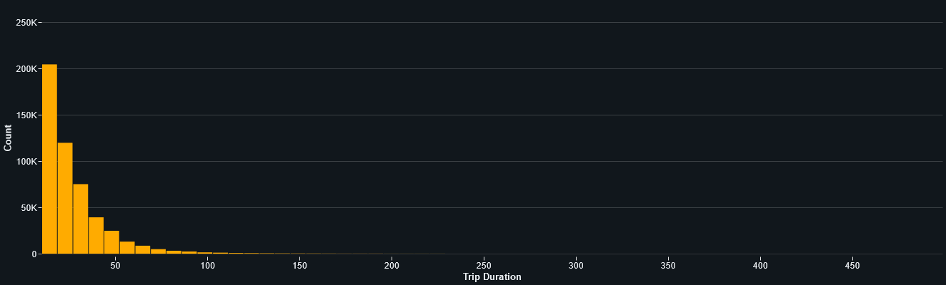
EDA Main Findings
High correlation, heavy skew and low variance
Skew
New cars and similar State-of-Health
Over-represented car model
Short trips in both time and distance
…
Correlation
Car and battery
Car and weight
Distance and time
…
Low variance
Trip were collected at the same season
Same temperatures
no other weather info
Notes:
as you know, no data set is perfect
the data was a bit skew regarding some features - only new cars with excellent SOH, one car model dominant the data, and most of the trips were under 10 minute (meaning they were relatively short trips)
some features were highly correlated. like the CAR feature (or example battery type, car weight) and obvious correlation between time and distance.
in addition, measurement spans across four month of winter, which means we have low variance in the temperature.

Slide 10
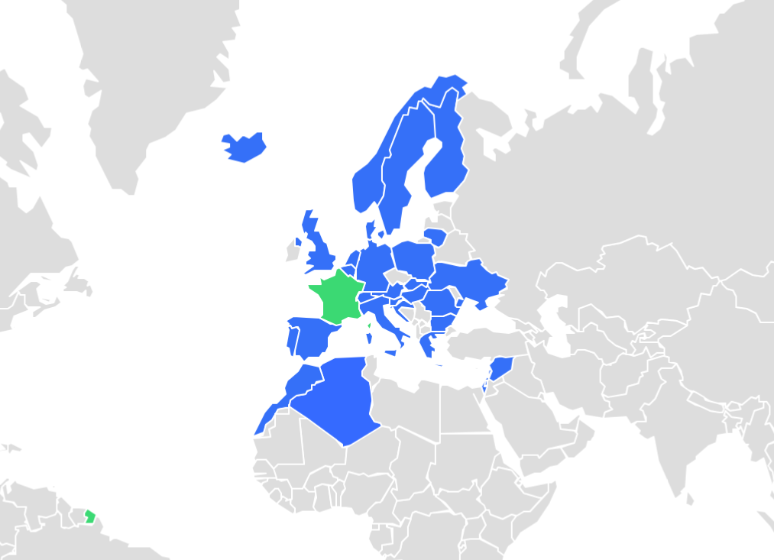
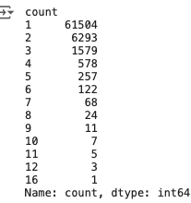
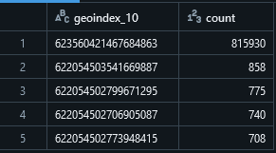
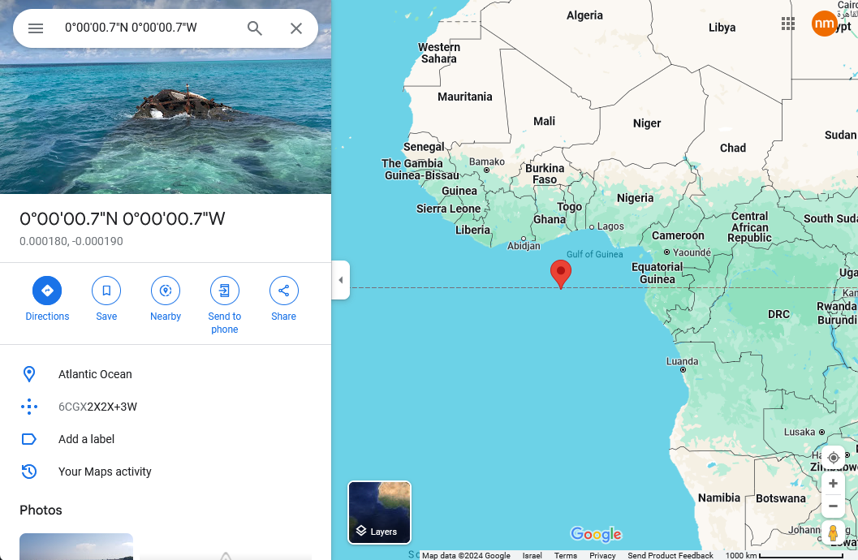
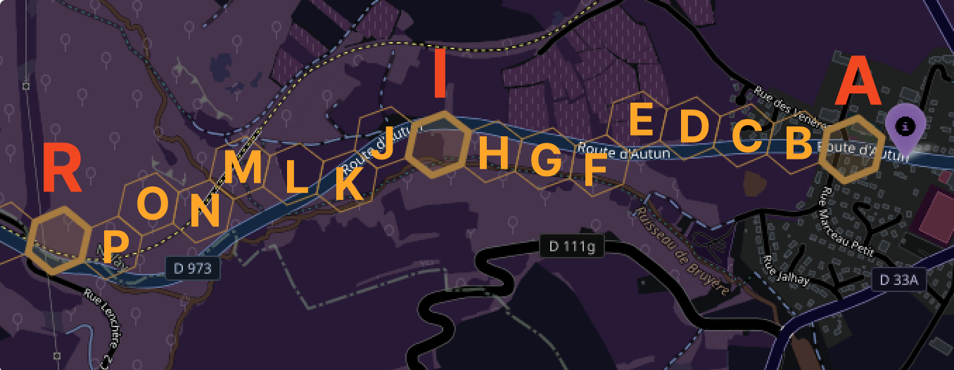
EDA Main Findings
Locations
Sparse locations
Missing trip segments (!)
Globalization (not a political stance)
Reading errors or lost treasure
Trips in countries outside of France
Where did we go through?
Lost at sea
Notes:
we noticed most hex (location) appear only once in the data. trips only contained some of its segments (hexs) , not a continuous overlapping segments we found that the most recurrent hex in the data was located deep under the atlantic ocean west of Africa data was collected based on cars that were sold in france, but it presents world wide trips and not only from France

Slide 11
Relevant Missing Data
Literature shows the importance of:
Weather
Traffic
Terrain
Driver Behaviour is crucial (!) but missing
Notes:
in our literature review we learned that some factors are very impactful on the battery consumption of EV.
those are weather, traffic, terrain and driver behavior.
so we had to resort to external sources in order to acquire some of this information

Slide 12
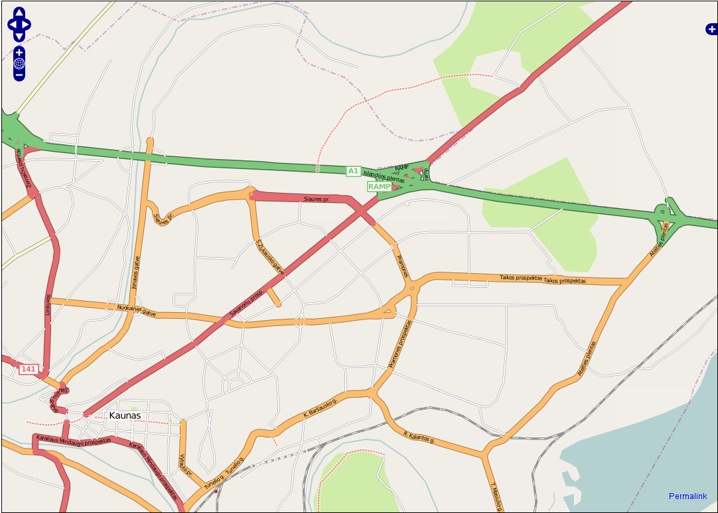
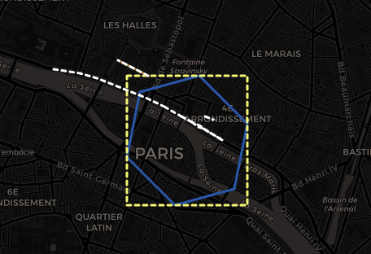
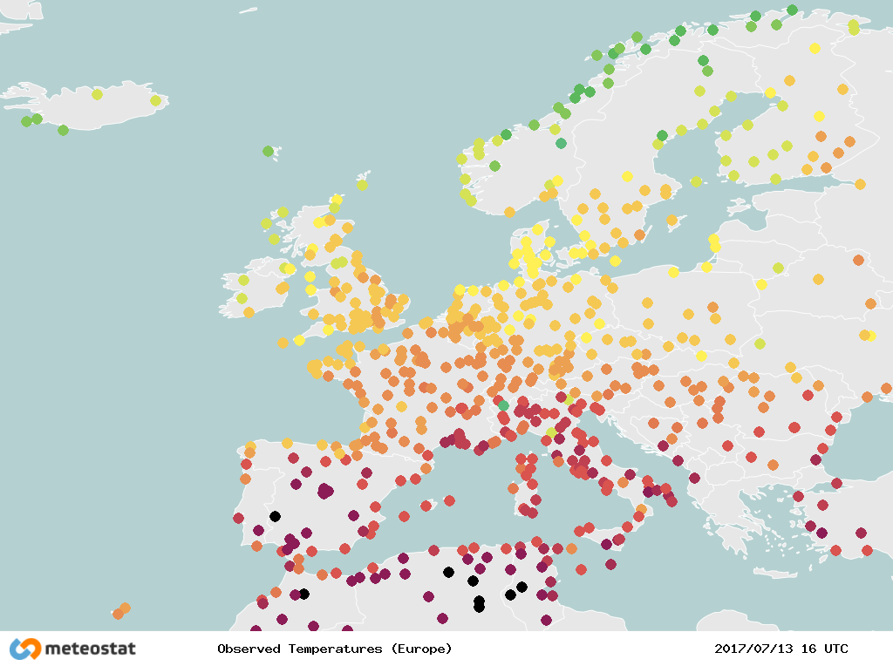
Additional Data Sources
Weather
NOAA
Meteostat
Traffic
TomTom
Route
OpenStreetMaps
OpenStreetMaps API
TomTom traffic incidents
Meteostat weather reading
Notes:
we have the NOAA and Meteostat, those are weather and climate database
TomTom can provide traffic info
and OpenStreetMap that is an excellent source for roads and geographical info

Slide 13
Data Pipeline
Features:
Trip progress indicator
Terrain proxy (using speed and altitude moments)
Distance (by odometer and H3)
Weather (Scale obstacle)
Route (Scale obstacle)
Enrichment
(optional)
APIs
Meteostat- weather
TomTom- Traffic
Raw Training Data
Preprocess
Rich
Segments
Data
Notes:
our feature engineering included
trip progress indicator
terrain proxy
distance, altitude & SOC difference
we used external sources of weather and roads but couldn't scale them

Slide 14
Method

Slide 15
Methodology and Modeling
General approaches
 | Segments | Trip
Static | ✔👈 | -
Traditional | ✔👈 | ✔👈
Trip vs. Segment
Trip - Predict trip at once
Segment - Sum segments predictions
Static vs. Traditional
Traditional - Supervised ML
Static - Cost per segment
Notes:
in order to solve the problem, we define two datasets and two ways to approach the task.
regarding the data, we looked at it from two angles: dataset of complete trips and dataset of segments of trips.

Slide 16
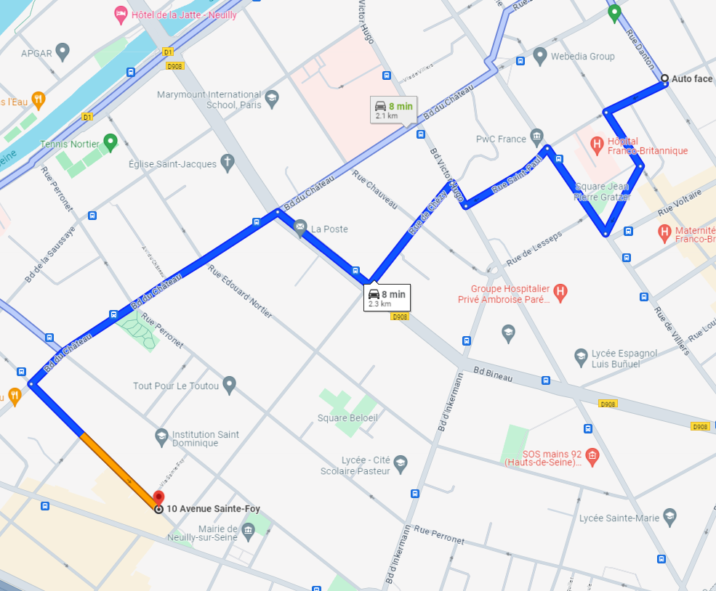
Methodology and Modeling
Trip-based dataset
Advantages:
Create compact dataframe - aggregate trips
Performance
Single prediction per trip
Disadvantages:
Ignores segment specific information
Flattens temporal and spatial information
Notes:
for the trips dataset, we group the data by trips. which means this dataset is a much more compacted and simple.
the target feature is the SOC change at the end of the trip.
the downside, is that we lose a lot of information regarding what happened during the trip.

Slide 17
Methodology and Modeling
Segment-based dataset
Advantages:
Informative data
High-volume data - Spark instead of Sklearn ☹️
Learn to characterize individual road segments
Disadvantages:
Slower inference (sequential)
Intermediate target*
Notes:
for the segment dataset, we group the data by segments (hex).
which means it is very rich in information and allow us to learn to characterize the hexes (road segment).
the target feature is the SOC change of an individual segment.
the downside is that we have a lot of data to process, which means it is resources intensiv.

Slide 18
Methodology and Modeling
General approaches
 | Segments | Trip
Static | ✔👈 | -
Traditional | ✔👈 | ✔👈
Trip vs. Segment
Trip - Predict trip at once
Segment - Sum segments predictions
Static vs. Traditional
Traditional - Supervised ML
Static - Cost per segment

Slide 19
Method
Traditional approach
Traditional approach:
the classic ML method, call the model to predict your target at real time.
applicable to any resolution - trip or segments.
the model predict the SOC at the end of the trip or segment.
the prediction of the current step is fed to the model as the starting SOC of the next one. trip SOC is accumulated.
advantages - receives real time data for prediction.
data pipeline:
choose the desired resolution - trip or segments.
data preprocessing
training- supervised regression task
Notes:
featuring engineer and selection, acquiring the target feature, collecting external data.
disadvantages - relative expansive processing time and compute power.

Slide 20
Methodology and Modeling
Traditional approach pipeline
Split
Enrichment
(optional)
APIs
Meteostat- weather
TomTom- Traffic
supervised regression task
Trips
Data
Test set
Raw Training Data
Model
Preprocess
OR
Segments
Data
Train set
OR
SOC for each segment
SOC for entire trips
Prediction current step is fed to the model as the starting SOC level of the next one. trip SOC is accumulated.
Trade-off - trip based or segments based.
sum
SOC for entire trips
Notes:
dynamic approach:
the classic ML method, call the model to predict your target at real time.
applicable to any resolution - trip or segments.
the model predict the SOC at the end of the trip or segment.
the prediction of the current step is fed to the model as the starting SOC of the next one. trip SOC is accumulated.
advantages - receives real time data for prediction.
data pipeline:
choose the desired resolution - trip or segments.
data preprocessing
training- supervised regression task

Slide 21
Method
Static approach
dynamic approach:
characterized segments SOC by similarity
target feature not trivial
advantages - can improve real time processing and compute power
disadvantages - once assigned, the prediction SOC is not updated.
data pipeline:
data preprocessing - remove all features that can't be associated with the segment (car, time, trip) - how many SOC classes are a good representative of the data?
training - supervised and unsupervised
Notes:
target feature
unsupervised or semi supervised?
the easy solution - have a lot of data and do statistics..
challenge - how many SOC classes are a good representative of the data? - how to find those SOC fixed value? - Storage of all costs - Capturing trip or car specific features
models: KNN - learn segments characteristic (supervised regression) Kmeans - number of clusters of SOC to build (unsupervised) KNN / Kmeans - find the best SOC values to assign each cluster (supervised)

Slide 22
Methodology
Static approach
seen Hex
get SOC
based on similarity
unseen Hex
SOC Costs ‘bank’
cluster 1 | SOC cost 1
cluster 2 | SOC cost 2
cluster 3 | SOC cost 3
cluster 4 | SOC cost 4
cluster 5 | SOC cost 5
cluster 6 | SOC cost 6
?
V SOC change = 0.1
V
SOC change = 0.2
?
?
V
SOC change = 0.3
Total trip SOC = sum of HEXes SOC V
Notes:
characterized segments by similarity
assign them with a fixed SOC change.
target feature not trivial
advantages - can improve real time processing and compute power (many simultaneous users worldwide)
disadvantages - once assigned, the prediction is not updated. - imply building a dataset for each segment possible.
data preprocessing - remove all features that can't be associated with the segment (car, time, trip) - how many SOC classes are a good representative of the data?
training - supervised regression task (defining the target is a challenge) - unsupervised and semi supervised clustering task.
target feature
unsupervised or semi supervised?
the easy solution - have a lot of data and do statistics..
challenge - how many SOC classes are a good representative of the data? - how to find those SOC fixed value?

Slide 23
Methodology and Modeling
Static approach pipeline
Model
APIs
Meteostat- weather
TomTom- Traffic
Train set
Split
Raw Training Data
SOC Costs ‘bank’
cluster 1 | SOC cost 1
cluster 2 | SOC cost 2
cluster 3 | SOC cost 3
cluster 4 | SOC cost 4
cluster 5 | SOC cost 5
cluster 6 | SOC cost 6
Preprocess
Rich
Segments
Data
Test set
Enrichment(optional)
Similarity
based
SOC for each segment
Soc for entire trips
sum
Notes:
characterized segments by similarity
assign them with a fixed SOC change.
target feature not trivial
advantages - can improve real time processing and compute power (many simultaneous users worldwide)
disadvantages - once assigned, the SOC prediction is not updated.

Slide 24

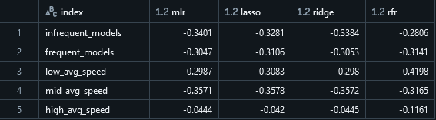
Evaluation metrics
Challenge: In absence of accepted metric, which should we use?
Favor over-estimation
Punish larger errors
Use various metrics
MSE - Model training and selection
MAE, MPE and MAPE - Intuitive interpretation
How much did we miss? (MAE)
Do we over or under predict on average? (MPE)
How off are we relative to the real value? (MAPE)
Evaluate trips slices
MAE | 1.702
MSE | 6.182
MAE | 1.702
MSE | 6.182
RMSE | 2.486
MAP | -35%
MAPE | 40%

Slide 25
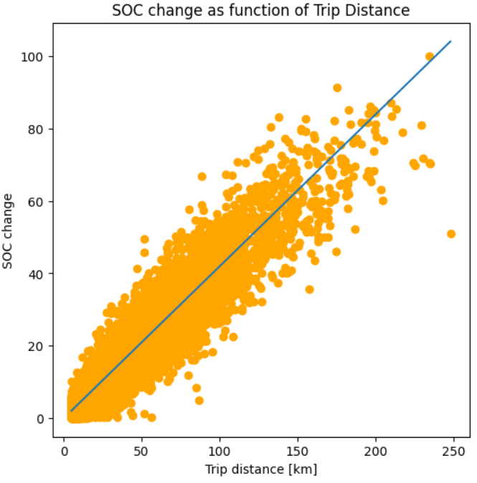
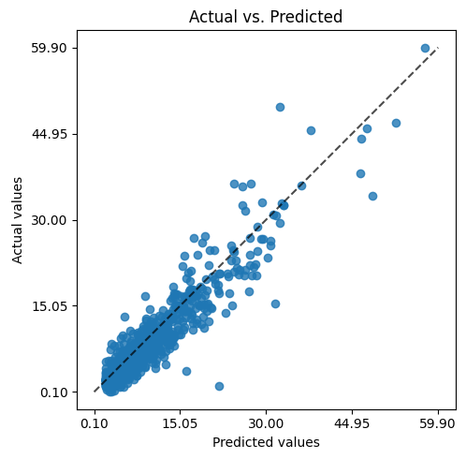
Models
Baseline model
coeff: 0.42
intercept: -0.042
R^2: 0.89
First feel of the data predictive power
Trip based traditional models
Linear Regression
LASSO
Ridge
RandomForestRegressor
No additional features
Evaluation metrics
MAE: 1.75
MSE: 6.52
RMSE: 2.55
RMSLE: 0.30
MAPE: 0.42

Slide 26
Models
Traditional models
and key parameters
XGBoost on Trips Data
nEstimators | 100
maxDepth | 6
learningRate | 0.3
RandomForest on Trips Data
n_estimators | 100
maxDepth | None (until leaves are pure)
We experimented with Random Forest for its simplicity and explainability
We used the XGBoost for its PySpark compatibility and robustness (12M instances!)
XGBoost on segments data
nEstimators | 100
maxDepth | 6
learningRate | 0.3
RandomForest on segments data
numTree | 10
maxDepth | 5

Slide 27
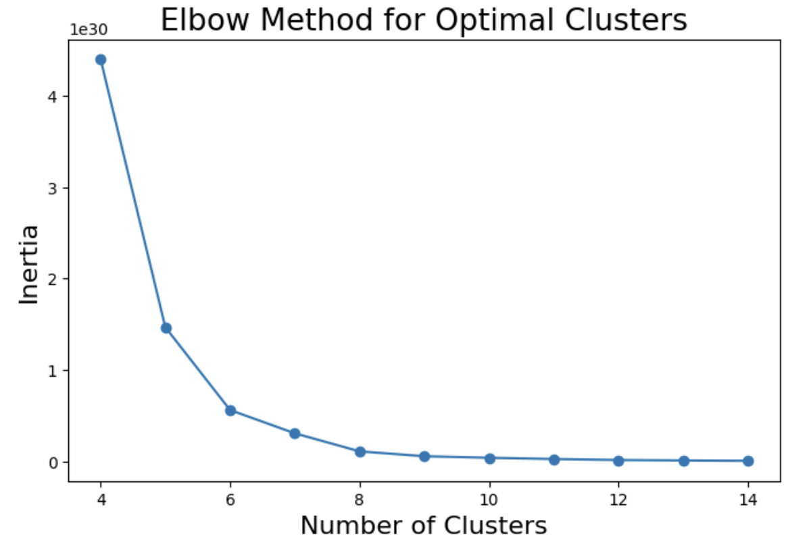
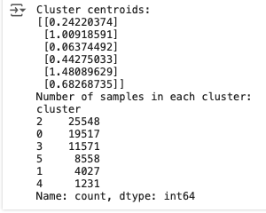
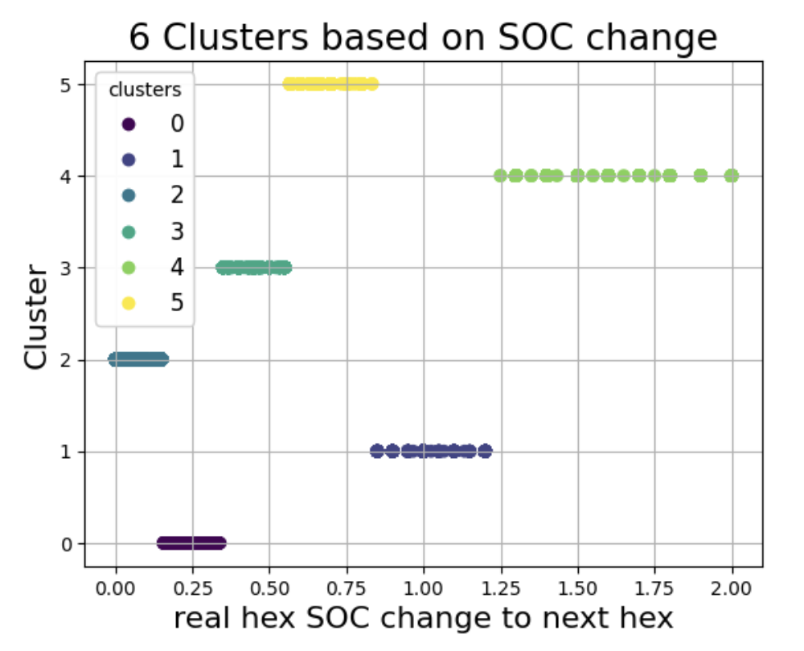
Static Baseline model
K-means optimal cluster number
K-means for clustering- based on segment SOC change - finds optimal number clusters - balanced distribution and spread of values
assign clusters SOC cost by avg SOC change within clusters
evaluate over the segment SOC change : ‘categorical’ y_pred (6 clusters) continues y_true (avg SOC change)
evaluate the accumulated trip SOC change
Notes:
as we said before, our static goal was to assign a fixed SOC cost to all segments exist..
so the static baseline model was as follow:
we took the segment dataset and did some adjustment to the feature.
we cluster all the data by the SOC change of the segments.
then we assign each cluster its predicted cost based on the avg SOC change within the cluster, and evaluate on the entire trip.
Another model we train for this task was a KNN regressor (for predicting the SOC cost, similar to the task of the dynamic model)
the evaluation was done on the accumulated SOC change of the entire trip.
the models you will see in the results was a train/test version of this K-means (evaluate cluster based on all of the data, build cluster SOC change based on that and evaluate on the entire trip (accumulated))
and another KNN regressor that got the real SOC change as a target and were evaluated on the entire trip.
not enough appearances of each hex in order to do statistics.
complicated to capture directionality (going up or down in the same segment lead to different SOC change)
basic
using similarity for clustering and then avg SOC change on cluster as a target
regressor using hex SOC change to next as a target

Slide 28
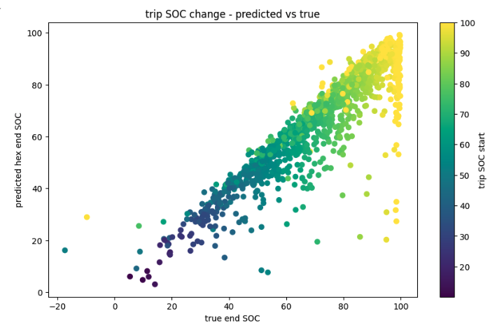
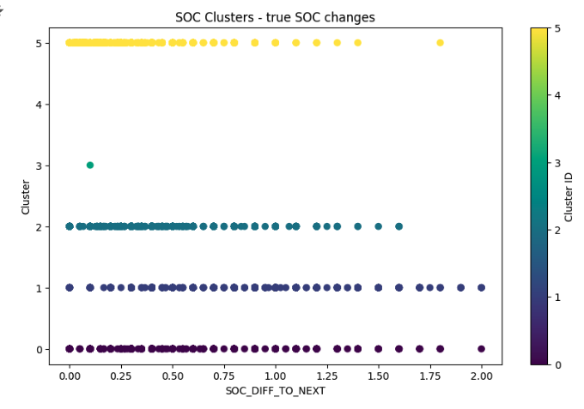
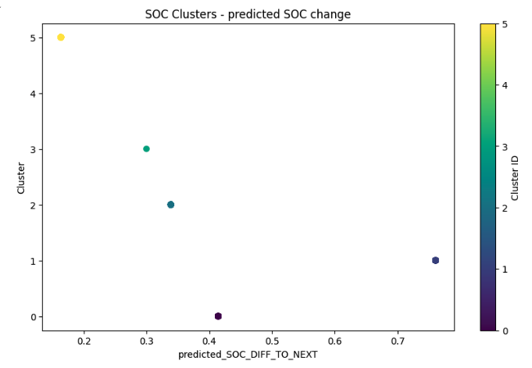
Static model
SOC change for entire trip. predicted vs. next_hex_difference
colorbar represent the true trip start SOC
SOC clusters based on all features, train set SOC change (next_hex_difference)
SOC clusters based on all features, test set SOC change (predicted_next_hex_difference)
Notes:
not enough appearances of each hex in order to do statistics.
complicated to capture directionality (going up or down in the same segment lead to different SOC change)
basic
using similarity for clustering and then avg SOC change on cluster as a target
regressor using hex SOC change to next as a target

Slide 29
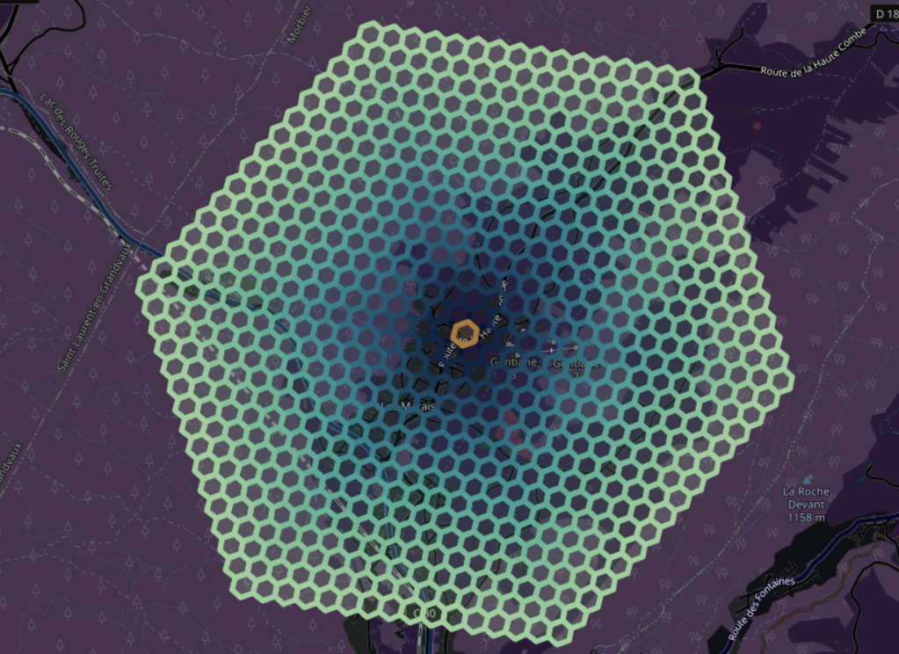
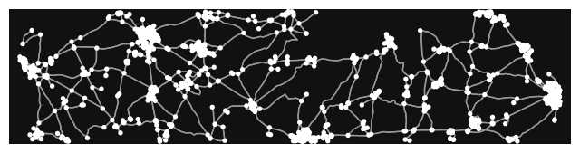
OpenStreetMap vs. H3
Naive polyfill is inefficient and inaccurate
Following road patterns improves accuracy and reduces number of segments*
Road properties integrated to the data
For a 50km radius area:
43391 H3 cells
46886 OSM roads
25229 undirected OSM roads
Naive isochrone prediction
Real roadmaps tend to be sparse

Slide 30
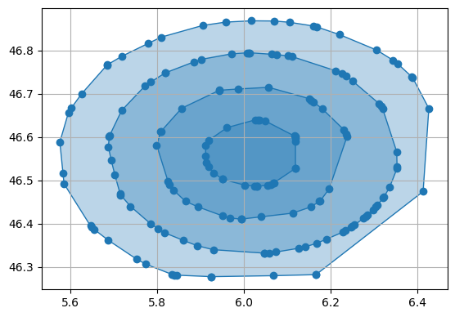
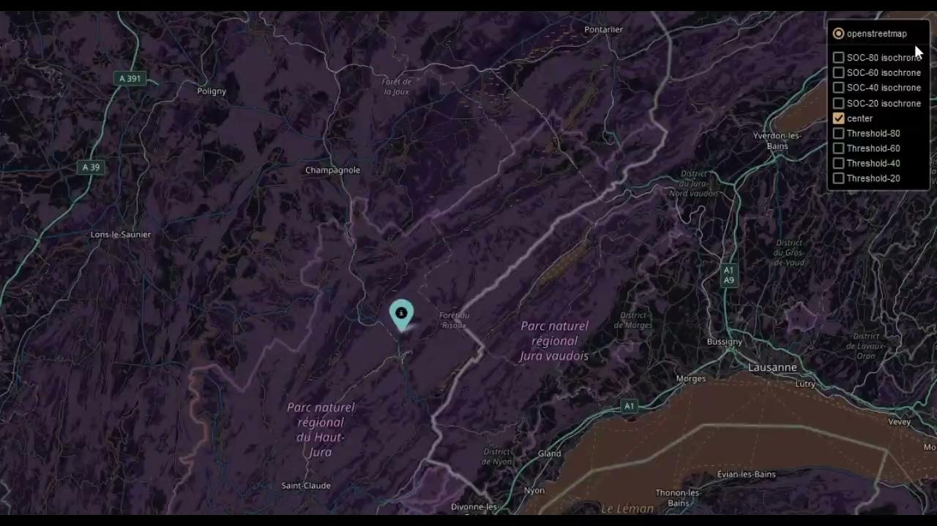
Isochrone predictions
Convex-hull
List road end nodes
Predict SOC for shortest-path route for each
Find convex hull at different thresholds
Underlying model evaluation is sufficient
Improve accuracy and efficiency by following road patterns
Convex Hull example
Naive isochrone prediction

Slide 31
Models Summary
Traditional models |  | metrics
 |  | MAE | MSE | RMSE | RMSLE | MAPE %
complete trips | OLS - Baseline | 1.75 | 6.52 | 2.55 | 0.30 | 42
 | XGboost | 1.46 | 4.83 | 2.20 | 0.25 | 30
 | RandomForest | 1.54 | 5.04 | 2.24 | 0.26 | 32
segments | XGboost | 0.30 | 0.68 | 0.83 | 0.09 | 6
 | RandomForest | 3.12 | 17.23 | 4.15 | 0.62 | 65
static models
segments | K-means clf | 6.24 | 110.58 | 10.51 | 0.76 | 14
 | KNN reg | 6.28 | 112.44 | 10.6 | 0.75 | 13
👑
Random Forest - simplicity and explainability
XGBoost - PySpark compatibility and robustness (12M instances!)
Notes:
KNN reggresor: Best Parameters: {'n_neighbors': 35, 'p': 1, 'weights': 'distance'}
Best Score (MSE): 0.05211333200025271
Regression Performance Metrics:
Mean Squared Error: 0.05389062875336607
R^2 Score: 0.4840146169637267

Slide 32
Conclusions

Slide 33
LESSONS LEARNED & TAKEAWAYS​
Dataset
Extend time period
Sample features more evenly
OSM over H3
Use OSM for segments
Importance of additional data sources
As literature review asserts
Evaluation metrics
Define consistent evaluation metric
Choose required metric attributes
Dynamic over Static solution

Slide 34

Next Steps
Research Static cost using OSM segments
Implement sequence prediction for segment based models
Collect and enrich trips with historical weather and traffic data
Model driver behaviour features
Re-train and test models on more balanced data
Implement isochrome prediction at scale

Slide 35
THANK YOU

